Slide 1
« Cerveau et Récompense » Episode 9 :

Slide 2
Cortex orbito-frontal

Slide 3

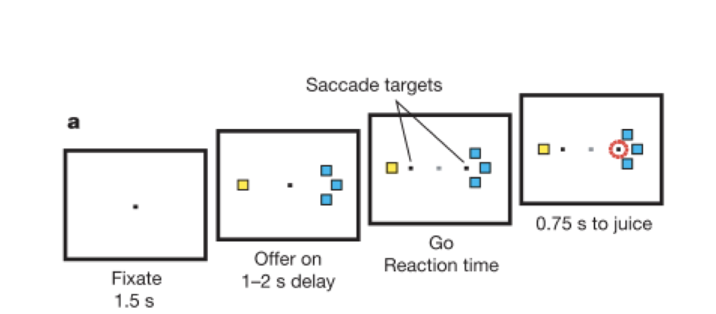
Camillo Padoa-Schioppa
Padoa-Schioppa & Assad (2006). Nature, 441 223

Slide 4
Le nombre de carré indique la quantité de jus de fruit
Camillo Padoa-Schioppa
Différentes couleurs
La couleur indique le type de jus de fruit que le singe peut obtenir
Padoa-Schioppa & Assad (2006). Nature, 441 223

Slide 5
Camillo Padoa-Schioppa
Padoa-Schioppa & Assad (2006). Nature, 441 223

Slide 6
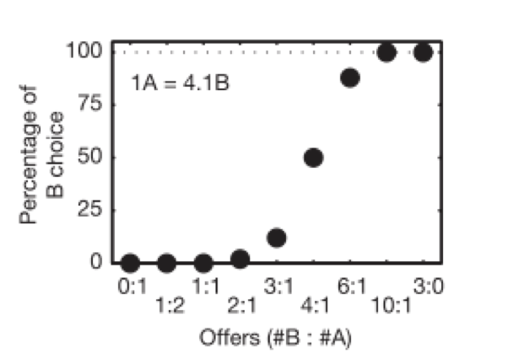
Camillo Padoa-Schioppa
Nombre de goutte du jus B : Nombre de goutte de jus A
Padoa-Schioppa & Assad (2006). Nature, 441 223

Slide 7
Camillo Padoa-Schioppa
Nombre de goutte du jus B : Nombre de goutte de jus A
Padoa-Schioppa & Assad (2006). Nature, 441 223

Slide 8
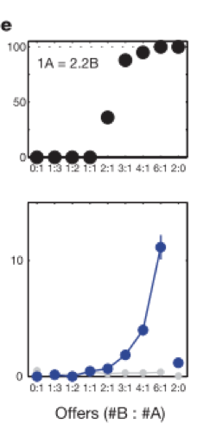
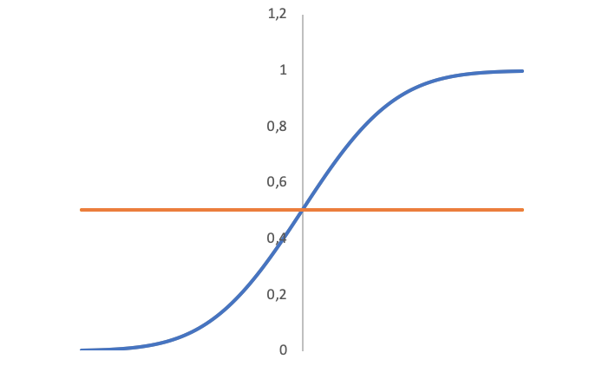
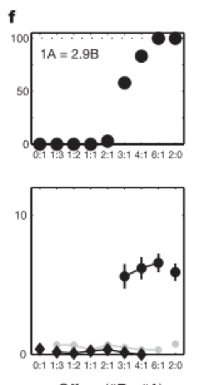
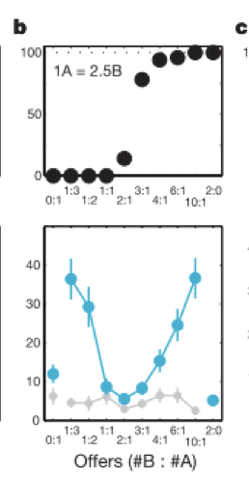
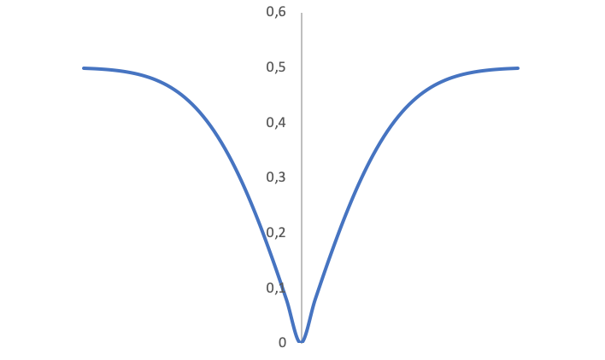
Valeur du choix B
Camillo Padoa-Schioppa
Valeur du choix A
Quantité de jus B
|V(A) – V(B)|
Padoa-Schioppa & Assad (2006). Nature, 441 223

Slide 9
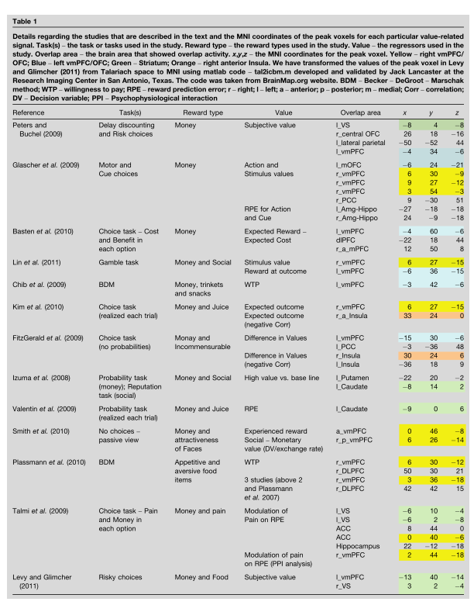
Levy & Glimcher (2012). Current opinion in neurobiology, 22, 1027

Slide 10
Levy & Glimcher (2012). Current opinion in neurobiology, 22, 1027

Slide 11
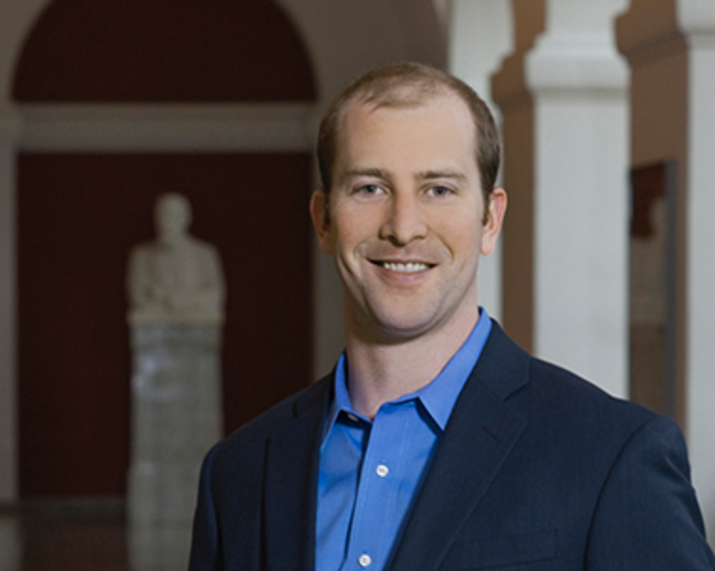
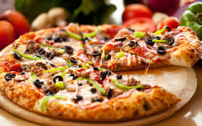
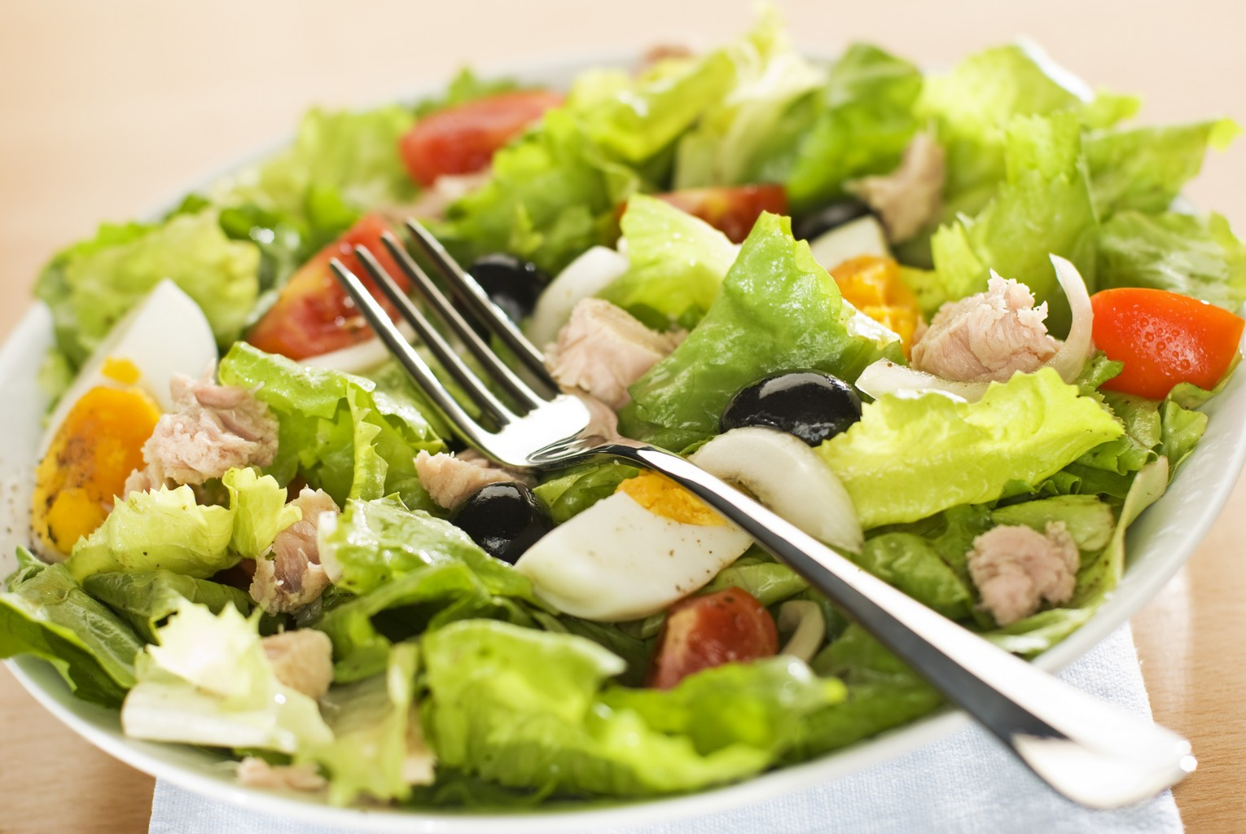
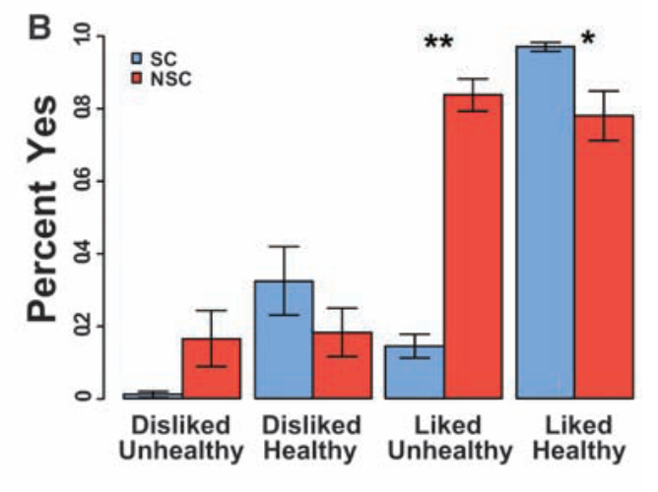
Est-ce bon pour la santé ?
Est-ce que vous aimez ce plat?
Todd Hare
Souhaiteriez-vous en manger ?
SC = self-control
NSC = self-control
Hare et al. (2009). Science, 324. 626

Slide 12
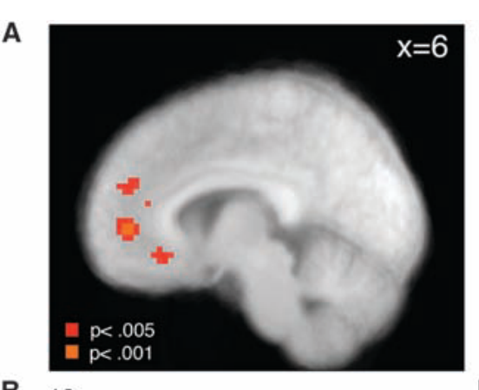
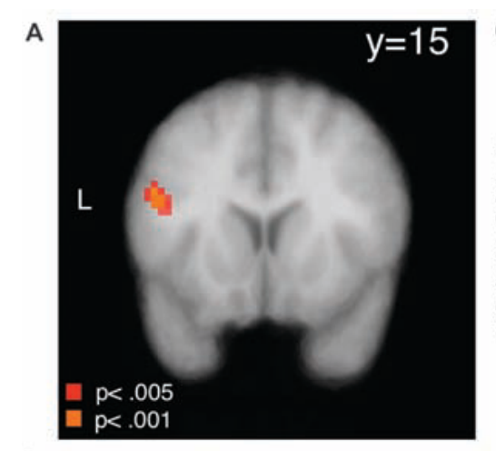
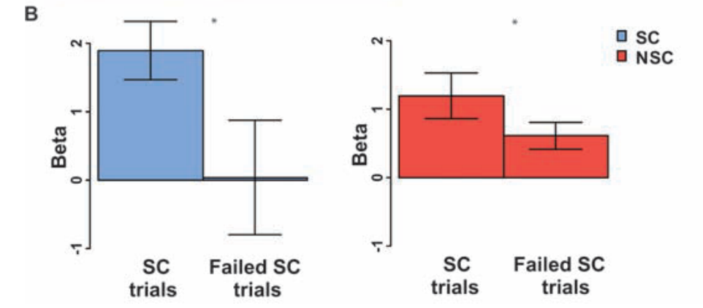
L’activité dans le cortex préfrontal ventro-médial est
corrélé avec les choix du sujet
Todd Hare
L’activité au niveau du cortex préfrontal dorso-latéral est plus élevé chez les sujets SC que chez les sujets NSC
L’activité au niveau du cortex préfrontal dorso-latéral est plus élevé chez les sujets SC que chez les sujets NSC
Hare et al. (2009). Science, 324. 626

Slide 13
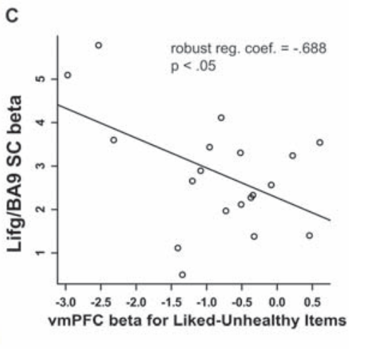
L’activité dans le cortex préfrontal ventro-médial est
corrélé avec les choix du sujet
Todd Hare
Corrélation négative entre l’activité du cortex préfrontal ventro-médial et celle du cortex préfrontal dorso-latéral
Le DLPF inhiberait l’activité du PFCVM pour réduire la valeur d’un stimulus apportant une forte satisfaction sur le court-terme mais ayant des conséquences moins souhaitable sur le long-terme
Hare et al. (2009). Science, 324. 626

Slide 14
Levy & Glimcher (2012). Current opinion in neurobiology, 22, 1027

Slide 15
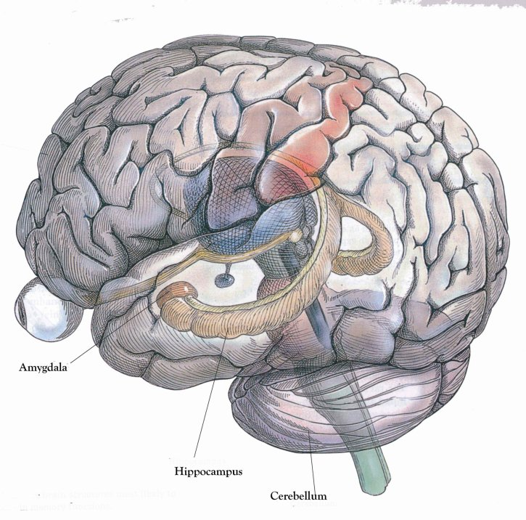
Amygdale
INSULA

Slide 16
TIME-OUT
Quel rôle jouerait le cortex orbito-frontal dans le processus de valuation chez le macaque ?
Quel rôle jouerait le cortex orbito-frontal dans le processus de valuation chez l’être humain ?
Quel rôle jouerait le cortex préfrontal dorso-latérall dans le processus de valuation chez l’être humain ?

Slide 17
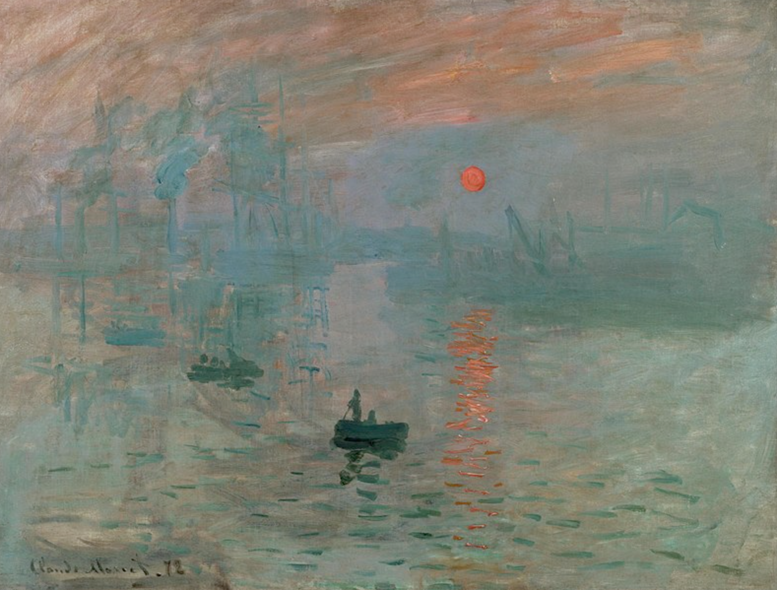
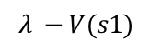
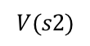

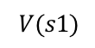
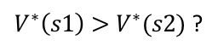
s1
Motor systems
Values
Prefrontal cortex
Striatum
Decision
$$V(s1)$$
YES
$V^{∗}\left(s1\right)>V^{∗}(s2)$ ?
Choose s1
Consequence of choosing s1
s2
$$V(s2)$$
Learning signal
Prediction error
NO
Food
$$λ −V(s1)$$
“Pleasure center”
Dopamine neurons
Choose s2
Consequence of choosing s2
Water
$$λ$$
Sex
Music?
« Internal reward currency »

Slide 18
Prefrontal cortex
Striatum
Subthalamic nuclei
Subtantia nigra pars reticula
Pallidum
Amygdala
Midbrain dopamine neurons
Lateral habenula
Norepinephrine
neurons
Rostro-medial
reticular nucleus
Pedonculopine nucleus
Based on Schultz (2015). Physiological Review, 95, 853

Slide 19
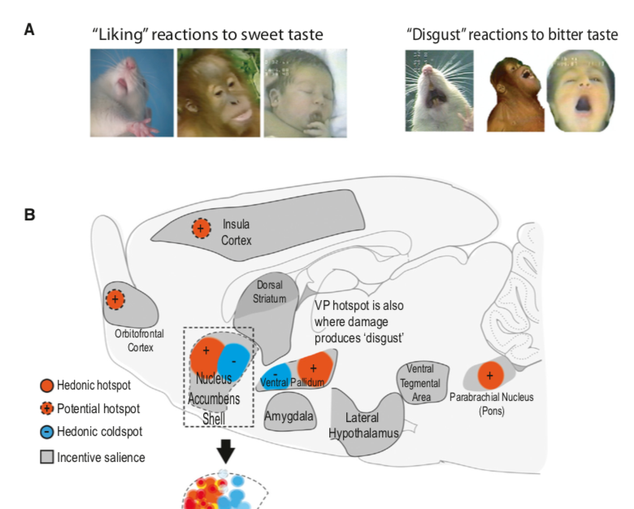
Berridge & Kringelbach (2015). Neuron, 6, 646
Notes:
. As for the idea of “pleasure centers of the brain”, it is still a current concept in neuroscience linked to the discovery of “hedonistic” hot spots in the brain of the rat (Figure 41). Whether a reward brings “pleasure” or not to a non-verbal organism can be inferred from facial expressions (when they have some). Figure 31 shows for instance the reaction of rats, monkeys and human babies to a sweet or a bitter taste. These reactions have been used by researchers as a way to infer how much “pleasure” a reward (usually the taste of sweet) brings to a rat. It has been discovered that stimulation of very circumscribed brain region by opioid or cannabinoid agonist increase facial reaction to sweetness in rats (hot spots) or on the contrary decrease them (cold spots). Opioid and canabinoid antagonists have the reverse effect. Figure 41 shows their location: NAc shell, ventral pallidum (which receives massive NAc input), parabrachial nucleus and maybe OFC and insula. Colds spots in NAc and ventral pallidum.

Slide 20
Berridge & Kringelbach (2015). Neuron, 6, 646
Notes:
. As for the idea of “pleasure centers of the brain”, it is still a current concept in neuroscience linked to the discovery of “hedonistic” hot spots in the brain of the rat (Figure 41). Whether a reward brings “pleasure” or not to a non-verbal organism can be inferred from facial expressions (when they have some). Figure 31 shows for instance the reaction of rats, monkeys and human babies to a sweet or a bitter taste. These reactions have been used by researchers as a way to infer how much “pleasure” a reward (usually the taste of sweet) brings to a rat. It has been discovered that stimulation of very circumscribed brain region by opioid or cannabinoid agonist increase facial reaction to sweetness in rats (hot spots) or on the contrary decrease them (cold spots). Opioid and canabinoid antagonists have the reverse effect. Figure 41 shows their location: NAc shell, ventral pallidum (which receives massive NAc input), parabrachial nucleus and maybe OFC and insula. Colds spots in NAc and ventral pallidum.

Slide 21
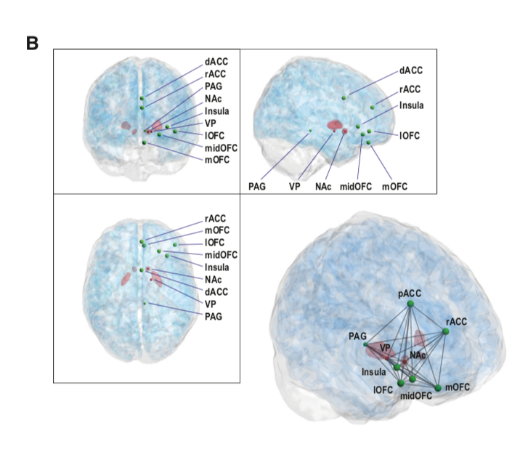
Berridge & Kringelbach (2015). Neuron, 6, 646
Notes:
If we follow Berridge & Kringelbach (2015), the study of self-stimulation in humans are not relevant to the issue of identifying the source of hedonistic reaction in humans. But besides betting the rat hotspot are conserved through evolution (I’m not aware of any study on the topic in other species, even monkey), do we have more direct data regarding the neural structures that might be responsible for the “pleasure” associated with a reward?
There are a few extremely rare cases of patients with lesion of the ventral pallidum, usually following an cerebro-vascular accident. They usually report a decrease in the pleasure they get from activity that used to please them but it is not clear how much weight to put on this clinical report as other factors might play a role (how often are those symptoms reported in AVC patient not suffering from a lesion of the ventral pallidum). On the other hand, there is a large amount of fMRI study that have looked at the brain response to a large amount of reward type: food, attractive face, erotic stimuli, face of a loved one, money, music, etc. They found the activation of a network of interconnected frontal area (plus in some studies, the ventral striatum) that overlap across reward types.
It is hard what to make of these results. First, with the potential exception of the ventral striatum which is activated in some of those studies, the region shown in the fMRI do not correspond to any of the hot spots identified in rats (the OFC hotspot in rats is not as well established as for the NAc or ventral pallidum one). Second, lesions of those areas do not provoke anhedonia but usually problems in decision-making and eventually reward preference. Most of these areas are also known to be involved in reward prediction (representation of values) which would fit with the symptoms of patients with frontal lesion while potentially explaining why they are activated in those research while being responsible to the hedonic reactions to a reward. Further research are needed. But besides that, further conceptual analysis might be required.

Slide 22
TIME-OUT
A quoi correspond en neurosciences le concept de « internal reward currency »?
Qu’est-ce qu’un hot spot ?
Les hot spots sont-ils les « centres de plaisir du cerveau » ?
Les données en neuroimagerie permet-elles d’identifier les régions impliqués dans la sensation de plaisir?

